Slide 1
ICT Entrepreneurship for
Telematics Services: Introduction
January 30th , 2013
T. Russell Hsing, PhD, FIEEE/FBCS(UK)/FSPIE
Email: thsing@ieee.org

Slide 2
Outline
Objectives, scope, and schedule of the course
Vehicular Telematics applications
Key components for ICT Entrepreneurship
What are the unique challenges in designing a consumer vehicle network
How to prepare a promising business plan
Blend Engineering (50%) with Business (50%)

Slide 3
Objectives of the Course
To discuss and understand (Both of Technology and Commercialization)
  Vehicular applications and networking requirements
  Key wireless technologies for vehicular communications
  VANET: Vehicular Ad hoc Networks
  Cloud Computing Platform, Big Data
  Ongoing and recent R&D activities (e.g. EU, Japan and US)
  IPRs and how to monetize it , and Technology Evaluation
  Negotiation, Game Theory, and Finance
  Commercialization
  Class Discussions: One Case Study and one or two Movies
  My wish list: Prepare a promising business plan for your own start-up

Slide 4
Course Requirements
What are not required
  No mid-term and final exams
  Lots of class discussions and interactions (via English)
What are required
  Every student is required to “actively” participate in class discussions that will start from today (January 30th, 2013)
    Everyone is required to identify and define a problem she/he believes is important and explain why; refine/change the problem after each class; discuss it at the beginning of next class
  Each of Students will be assigned to present one technical paper
  Every student is “hopefully” required to complete his (her) project
    Students may use the topic they identified and defined, or
    Project options I will suggest to you
Final class presentations (optional)
  final term paper presentation (technical paper or business plan)

Slide 5
Some Ground Rules for Class Discussions
Free brain storming (I expect our class will be highly interactive and brain storm among us!)
No ideas are bad ideas; No judgment on right or wrong for any idea
I expect you to have YOUR own thoughts and ideas
Will be highly encouraged to contribute your own thoughts toward identifying, formulating, defending, and finally solving problems
My Wish List:
A few conference papers for submissions will be expected by the end of this class (technical track)
To have at least one business plan from you (business track)

Slide 6
European R&D Activities: Framework Program 6
COOPERS- Co-operative Systems for Intelligent Road Safety (2006- 2010): Telematics Applications for Cooperative traffice management
Cooperative Vehicle- Infrasturcture Systems (CVIS) (2006-2010): Development & Testing on V2I, Make ue of Wave-related interface for vehicular Telematics Applications
SAFESPOT (2006- 2010): Design Cooperative Systems for
Road Safety based on V2V and V2I communications
PReVENT (2006- 2008): Develop Preventive Safety Applications and Technologies; Have the Sub-project WILLWARN (Wireless Local Danger Warning) based on IEEE 802.11 a/p; Secure Vehicular Communications (SeVeCom, 2006- 2008)

Slide 7
European R&D Activities: Framework Program 7
Field Operational Tests, such as PRE-DRIVE- C2X
(Preparing the building block required for successful field
operational tests of VANET in Europe)

Slide 8
Japanese R&D Initiatives:
V2I Communications standard was published in 2001
-(DSRC @ 5.8GHz (TDMA) with range of 30 meters for ETC
applications)
-In 2008, more than 20M OBU (On Board Unit) for ETC were
deployed in Japan
National ITS Safety 2010 Initiative: V2I and V2V
In June 2007, it was announced that a 10MHz channel in the
700 MHz frequency channel will be allocated for safety-
related V2V communications in 2012

Slide 9
USA R&D Initiatives:
VII (Vehicular Infrastructure Integration >> POC (Prof of Concept >> Connected Vehicles
Vehicle Safety Communications- Applications Project (completed in 2009)
UMTRI (Integrated Vehicle- Based Safety Systems:
Human- Machine Interface
Cooperative Intersection Collision Avoidance System Project
with three components: Violation Warning Project (Michigan),
Stop Sign Assist Project (Minnesota), and Signalized Left
Turn Assistant Project (California)
Safe Trip- 21

Slide 10
My Office: Room 625, Engineering Building No. 3
My office phone number: Ex. 56692
My email: thsing190@gmail.com
thsing@ieee.org

Slide 11
Preview on My talk at the Korea Telecom

Slide 12
The Vehicle Safety Problem
About 6 million motor vehicle crashes occur every year in the United States,
  In 2009, ~5,505,000 vehicle crashes occurred, leading to 33,808 fatalities and 2,217,000 injured people
  These numbers account only for police-reported motor vehicle crashes only.
  An average of 93 people died each day (one every 16 minutes) in the same year.
Vehicle crashes result in huge economic cost to society
  ~2.3% of the U. S. Gross Domestic Product in 2000
Intersection collisions accounts for a significant portion of the total accidents.
  In 2007, ~2,392,061 intersection crashes occurred, accounting for 39.7% of the total number of crashes.

Slide 13
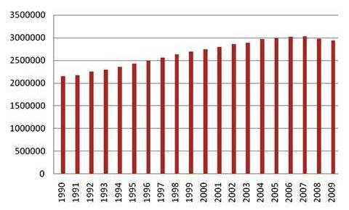
Annual Fatality Rates per 100 Million VMT

Slide 14
Leading Causes of Vehicle Crashes
Driver error: 95% of the time due to recognition, decision, performance, non-performance, and other or unknown driver errors
  Recognition errors (inadequate surveillance, distraction, … ): 40.6%
  Decision errors (speeding, …): 34%
  Performance errors: 10.3%
  Non performance: 7.1%
  Other and unknown causes: 7.9%

Slide 15
Leading Scenarios of Vehicle Crash's
Intersection or turning (~36%)
Road edge departure without prior vehicle maneuver (~33%)
Lead vehicle stopped (~12%)

Slide 16
Vehicular Communication Applications
Autonomous Driving
Cooperative Driving
Safety Applications
Cooperative Safety Applications
Vehicular Communication Capabilities
Mobility Applications
Consumer & Commercial Applications
Environment Sustainability Applications
Time

Slide 17
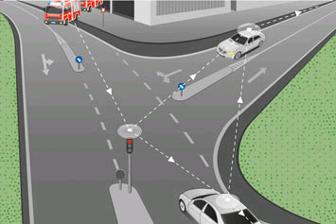
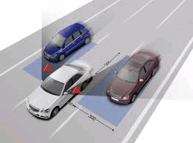
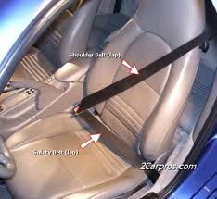
From Passive Safety to Cooperative Safety
Active Safety
Cooperative Safety
Autonomous Safety
Passive Safety
Anti-lock Brakes
Brake Assist
Electronic Stability Control
Autonomous Sensors
Adaptive Cruise Control
Lane Change Assist

Slide 18
Cooperative Safety
  Intersection collision avoidance
  Lane/road departure
  Road condition warning
  Emergency electronic brake lights
  …

Slide 19
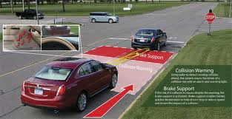
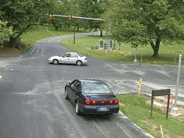
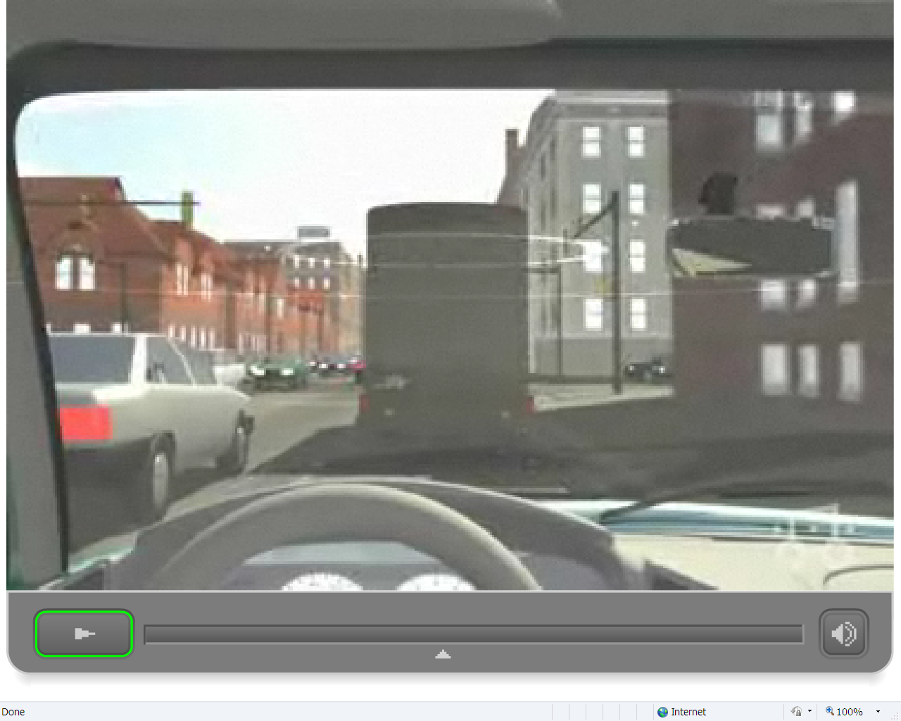
Intersection Collision Avoidance

Slide 20
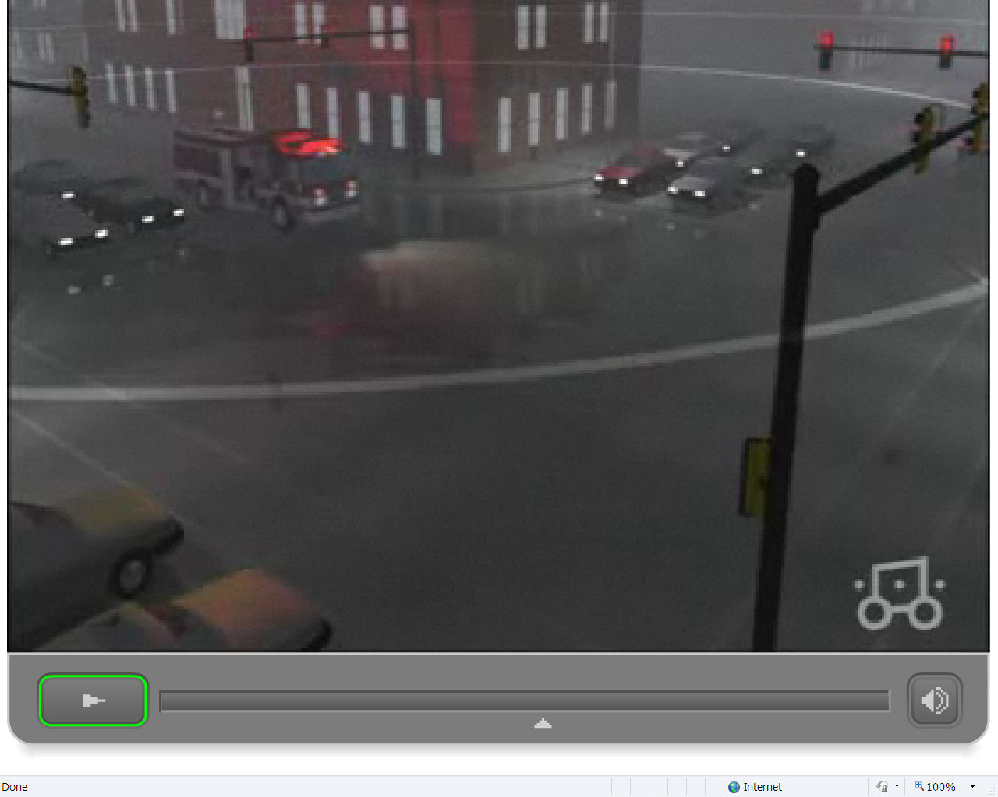
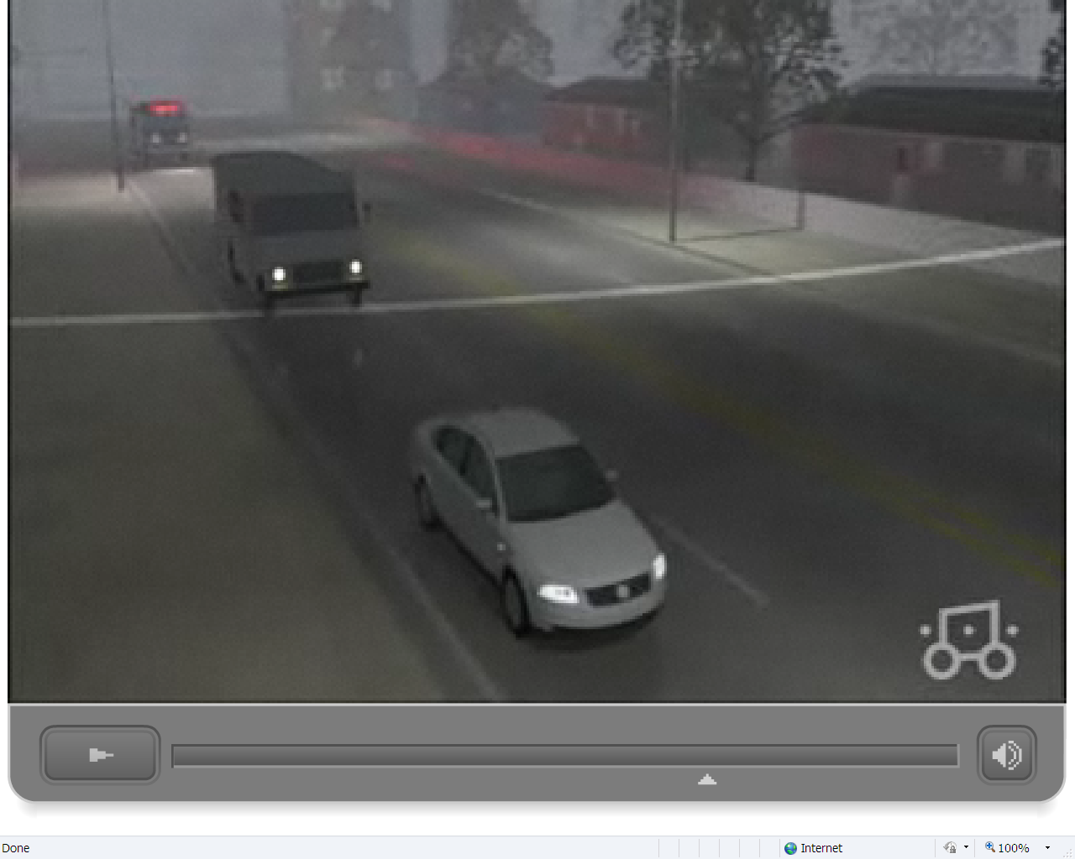
Emergency Vehicle Warning
Caution! Emergency Vehicle Approaching!

Slide 21
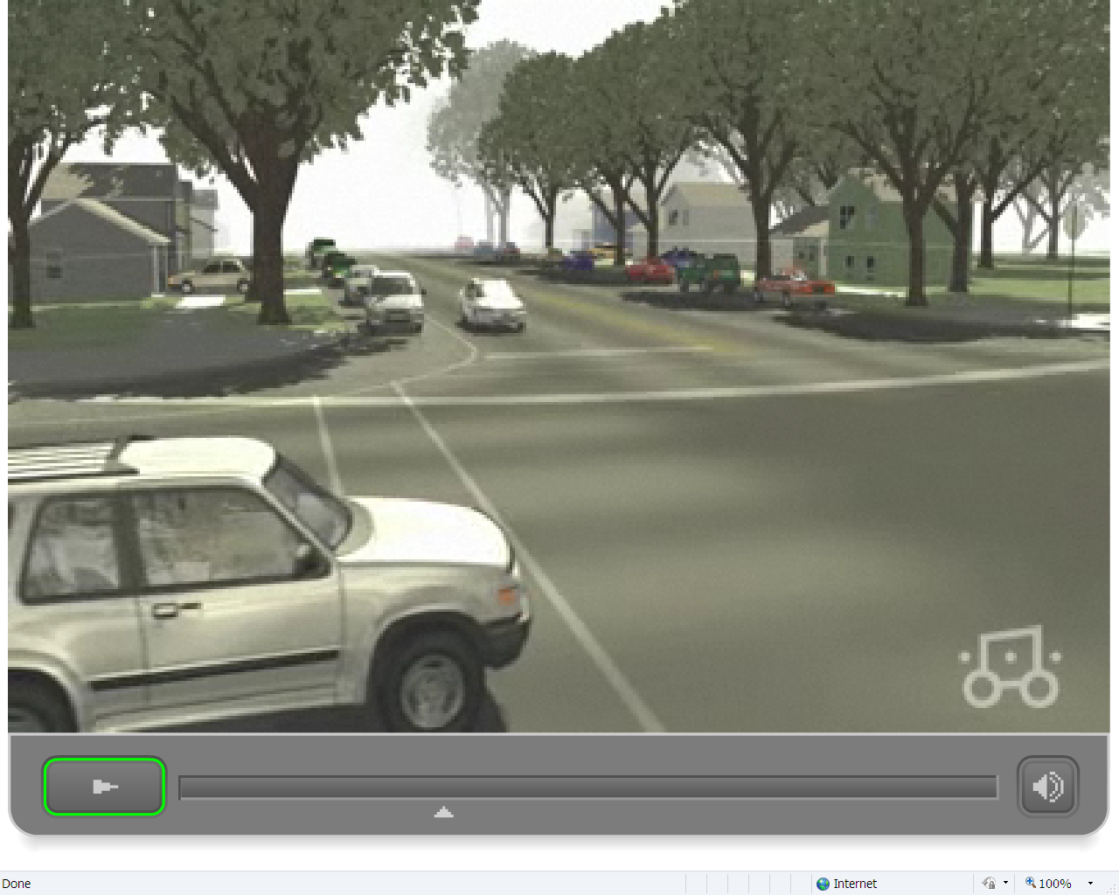
Intersection Collision Avoidance
Caution! Red Light!

Slide 22
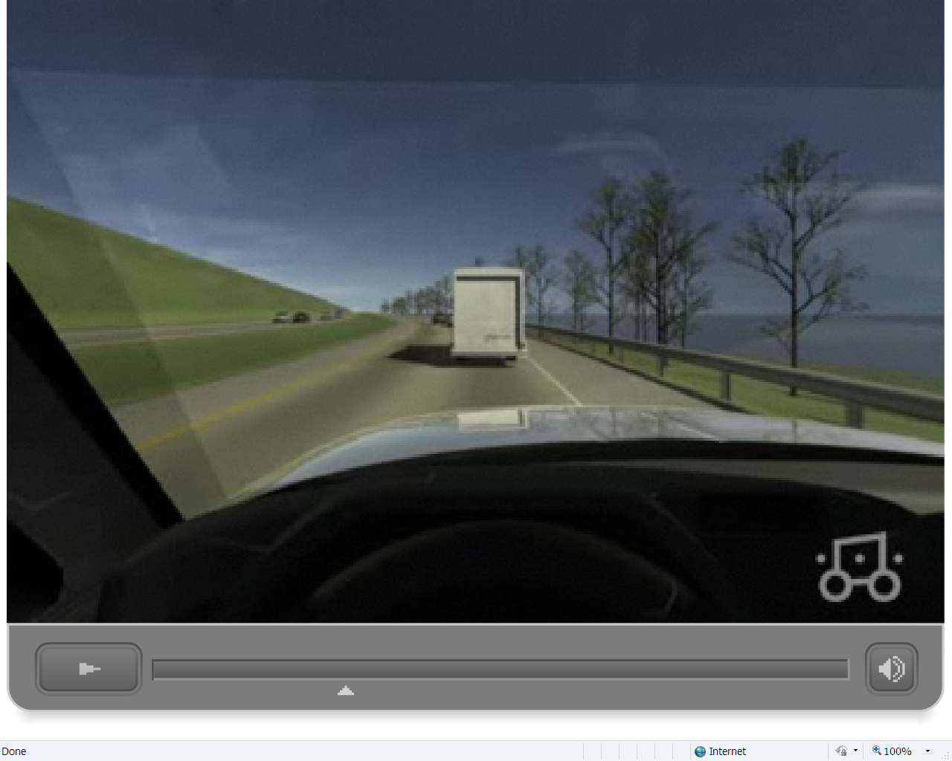
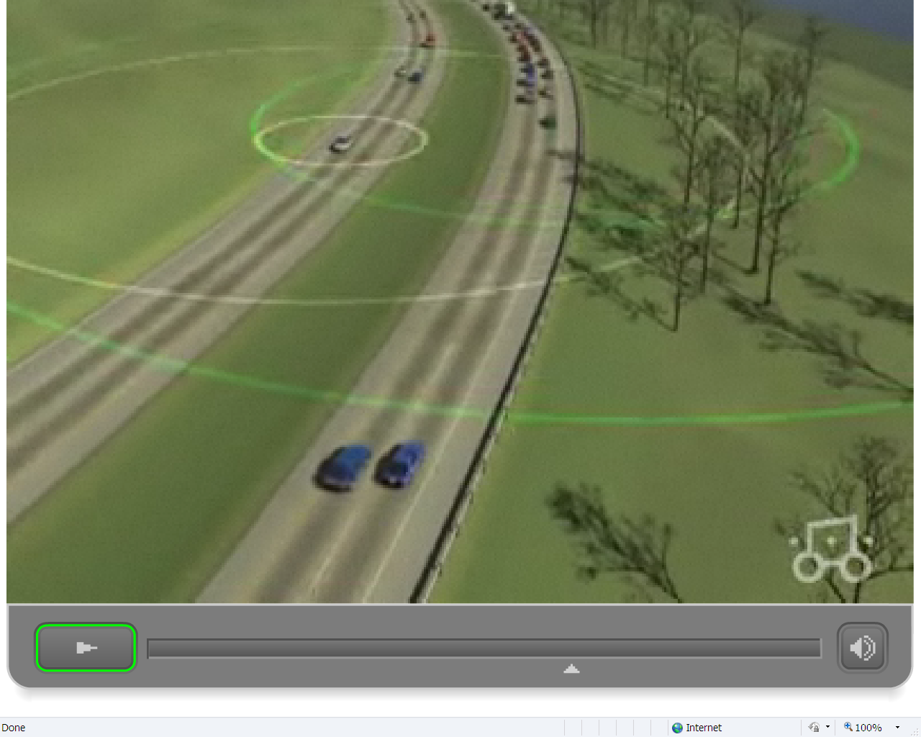
Inter-Vehicle Hazard Warning
Warning! Vehicle Breaking Ahead!

Slide 23
Consumer and Commercial Services
  Toll payment
  Parking location assistance
  Parking access & payment
  Vehicle diagnostics/prognostics
  Food drive-through payment
  Concierge assistance
  Software/firmware updates
  ……
  * Responsible for 50% of all crashes & fatalities

Slide 24
Mobility Applications
  Probe data
    Average speed
    Travel time
  Roadway conditions & incidents
  Real-time traveler Info
    En-route alerts
    Congestion maps
    Dynamic routing & navigation assistance
    Weather alerts
    Ramp metering
  Emergency response

Slide 25
Sample Existing Systems
  GM OnStar
  Hyundai
  Ford Sync
  BMW
  Mercedes-Benz
  Toyota
  And almost every other car brand …..

Slide 26
Uniqueness of Consumer Vehicles Networks
Most security threats in a consumer vehicle network will be insider attacks.
  Adversaries can purchase legitimate vehicles with valid security credentials and use them to participate in vehicle safety communications as innocent drivers.
  Adversaries can use the valid security credentials on these vehicles to send malicious messages to endanger other vehicles.
  Difficult to distinguish which vehicles are innocent and which are malicious or misbehaving.
  Previous network security designs have commonly assumed that the primary security threats are from outside attackers.

Slide 27
Uniqueness of Consumer Vehicles Networks
Consumer vehicle communications are often highly transient.
  When vehicles meet with each other, they often stay within each other’s radio ranges for a very short time period – often as short as a few seconds
  Previous studies of MANETs have conventionally assumed that neighboring vehicles will stay wirelessly connected with each other for much longer timeframes
When a consumer vehicle takes a trip each time, it will likely meet many vehicles that it has never met before.
  They may not have any prior knowledge on each other’s trustworthiness.
  They must determine the untrustworthiness of the messages they receive from each other immediately in order to support highly time-sensitive cooperative safety applications.

Slide 28
Uniqueness of Consumer Vehicles Networks
Most vehicles in a CVN belong to individual consumers.
  Communication devices will not be managed by IT organizations or experts.
  Many vehicles may not be able to communicate frequently with infrastructure networks
  Fixing problems or making changes to the vehicle communication hardware or software will typically require vehicles to be brought to service centers, which will be time-consuming, inconvenient, and often costly to drivers.
CVNs will be significantly larger than MANETs people have studied.
  Approximately 256 million registered vehicles in the United States
  MANET designs have focused on much smaller networks targeting typically up to thousands of vehicles.

Slide 29
Uniqueness of Consumer Vehicles Networks
Consumer vehicles are highly cost-sensitive
  Communication devices on vehicles will have limited computing powers

Slide 30
Some Implications of the Uniqueness
Communication, security and privacy protection solutions for consumer vehicle networks must be able to support over 250 million vehicles.
This large network size makes many technologies designed for MANETs unsuitable for CVNs.
  Prohibitively resource-intensive to frequently distribute large amounts of data to and among vehicles
  Impractical to require each vehicle to store information about every other vehicle
  Decisions that impact drivers must have very low error rates
  …

Slide 31
Some Implications of the Uniqueness
The need to protect privacy requires new designs of security credential and trust management mechanisms
  More difficult to detect misbehaving vehicles
  ……
To avoid unnecessary interruptions and costs to vehicle drivers, the communication, security and privacy protection mechanisms must function effectively without forcing innocent drivers to bring their vehicles to service centers frequently or requiring vehicles to have frequent vehicle-to-infrastructure network connectivity

Slide 32
Some Implications of the Uniqueness
The highly transient radio connectivity among vehicles demands that
  Vehicles be capable of rapidly establishing trust in received messages
  Networking solutions meet stringent delay requirements of the vehicle safety applications.
Limited computing power of OBU means that
  Processing on a vehicle cannot be overly computational intensive and yet must be able to process the potentially thousands of incoming messages per second while meeting the stringent delay requirements of the vehicle safety applications.

Slide 33

Modes of Vehicular Communications
I2V Message
Dissemination Servers
Infrastructure-based
Servers and Applications
4. I2V
message
dissemination
3. V2I bidirectional
communication
1. V2V local
broadcast
2. V2V multihop
message
dissemination

Slide 34
Some Technical Challenges
Vehicular communication technologies
  Short-range radio such as DSRC
  Long range radio such as LTE
Privacy and security
  What are the challenges
  What are the state of the art solutions
  What are the remaining problems
Message dissemination
  What are the state of the art solutions
  What are the remaining problems
Positioning
  How to achieve adequate positioning at low price
Vehicle control based on communication
……

Slide 35
What Problems Do You See
As Important to Address and Why?

Slide 36
Thanks !

